Slide 1
LWP identification

Slide 2
Problem statement
we need to identified user Home ,work & hangout location.
Solution
After getting GMM significant cluster first we need to clean the overlapped cluster.
Need to identity top 2 cluster.
Create Bit Pattern of user in each Cluster
Create feature for classification of home & work
After classification check similarity in cluster and tag as below :
Similar home cluster tag as secondary home.
similar Work cluster tag as Secondary Work.
Rest as Hangout cluster.

Slide 3
To clean the overlapped cluster
Step 1
Check cluster Size it should be less than 3Km.
Step 2
Take median lat-long of cluster using group-by
Step 3
Take distance b/w each cluster
Step 4
Discard cluster which distance are less than 1 Km.
Note: we also check with top lat-long of cluster. But median lat long work much better than top lat-long of cluster.

Slide 4
Need to identity top 2 cluster for classification of home & work
Test 1 : After we getting clean overlapped clusters we take cluster on basis of top duration.
Problem:
in many cases we see clusters which are same pattren are come in top 2 cluster because they are high duration than work cluster.
Some time cluster which are available less than 3 Hour are come in top 2 cluster which impact result of classification
Test 2:to over come this problem we use wattage factor :multiple of duration*unique days*hour spend.
Problem:
it will help to remove those cluster which are available less than 3 Hour are come in top 2 cluster.
But still have cluster in top 2 which have same pattren as home-home or work-work.
Test 3: To fine top 2 cluster which are different in pattren we use bit pattren of cluster with hamming Distance and take one cluster form same pattren cluster.
Note: By this we get cluster which are different in pattren from each other and also remove those cluster which are available less than 3 Hour are come in top 2 cluster

Slide 5
Bit Pattern of user in each Cluster
Take user data on cluster Level
We have tried Bit Pattren on :
Duration level.
Occurrence .
Unique day count.
Multiple of Duration with Unique.
Multiple of Duration with Sq of Unique days.
Aggregate Duration spend on imsi,Cluster,Dayofweek& Hour
Take 10 percentile of duration excluded 0
Check for every hour duration is >=10 percentile mark as ‘1’ else ‘0’
But as analysis of all bit Pattren we are Selected Duration Level Bit Pattren
Check for every hour duration is >=10 percentile mark Bin as ‘1’ else ‘0’
Take Sum of bins for dayofweek for each hour
Check if every hour Sum of bin are grater than 2-mark Bin as ‘1’ else ‘0’

Slide 6
Classification
To classify top 2 cluster in Home & Work first we need to create feature
Duration Spend distribution in cluster
Perc Unique day spend in cluster
Perc Weekend spend in cluster
Perc Weekday spend in cluster
Hour Spend Distribution in cluster
Hamming Distance with Home pattren
Hamming Distance with Work pattren
Week count Spend

Slide 7
Feature distribution
Percentage Duration in Cluster
Work |  |  |  |  |  | Home
Group Bins | Count of percent_dur_cluster | percent_dur_cluster sample |  |  |  | Group Bins | Count of percent_dur_cluster | percent_dur_cluster sample
0-0.2 | 14 | 40% |  |  |  | 0-0.2
0.2-0.4 | 8 | 23% |  |  |  | 0.2-0.4 | 2 | 6%
0.4-0.6 | 11 | 31% |  |  |  | 0.4-0.6 | 11 | 31%
0.6-0.8 | 2 | 6% |  |  |  | 0.6-0.8 | 8 | 23%
 |  |  |  |  |  | 0.8-1 | 14 | 40%
Total_unique_day
Group Bins | Count of Total_unique_day | % of Total_unique_day |  |  |  | Group Bins | Count of Total_unique_day | % of Total_unique_day
0.2-0.4 | 1 | 3%
0.4-0.6 | 18 | 51% |  |  |  | 0.4-0.6 | 8 | 23%
0.6-0.8 | 15 | 43% |  |  |  | 0.6-0.8 | 18 | 51%
0.8-1 | 1 | 3% |  |  |  | 0.8-1 | 9 | 26%
count_of_weekend
Group Bins | Count of count_of_weekend | % of count_of_weekend |  |  |  | Group Bins | Count of count_of_weekend | % of count_of_weekend
0-0.2 | 3 | 12% |  |  |  | 0-0.2 | 1 | 3%
0.2-0.4 | 14 | 54% |  |  |  | 0.2-0.4 | 2 | 6%
0.4-0.6 | 4 | 15% |  |  |  | 0.4-0.6 | 10 | 29%
0.6-0.8 | 4 | 15% |  |  |  | 0.6-0.8 | 12 | 34%
0.8-1 | 1 | 4% |  |  |  | 0.8-1 | 10 | 29%

Slide 8
Feature distribution
count_of_weekday
Group Bins | Count of Avg_over a week | % of Avg_over a week |  |  |  | Group Bins | Count of Avg_over a week | % of Avg_over a week
2-3 | 3 | 9% |  |  |  | 3-4 | 12 | 34%
3-4 | 16 | 46% |  |  |  | 4-5 | 12 | 34%
4-5 | 15 | 43% |  |  |  | 5-6 | 9 | 26%
5-6 | 1 | 3% |  |  |  | 6-7 | 2 | 6%
Hour Spend in cluster Distribution
Group Hour Bin | Count of Hour_spend_in_cluster | % of Hour_spend_in_cluster
0-0.2 | 3 | 9%
0.2-0.4 | 10 | 29%
0.4-0.6 | 19 | 54%
0.6-0.8 | 3 | 9%
Group Hour Bin | Count of Hour_spend_in_cluster | % of Hour_spend_in_cluster
0.2-0.4 | 3 | 9%
0.4-0.6 | 17 | 49%
0.6-0.8 | 12 | 34%

Slide 9
Feature Selection
On Basis of correlation in feature and its distribution we have select 4 Feature for Classification
Duration Spend distribution in cluster
Perc Unique day spend in cluster
Perc Weekend spend in cluster
Hour Spend Distribution in cluster

Slide 10
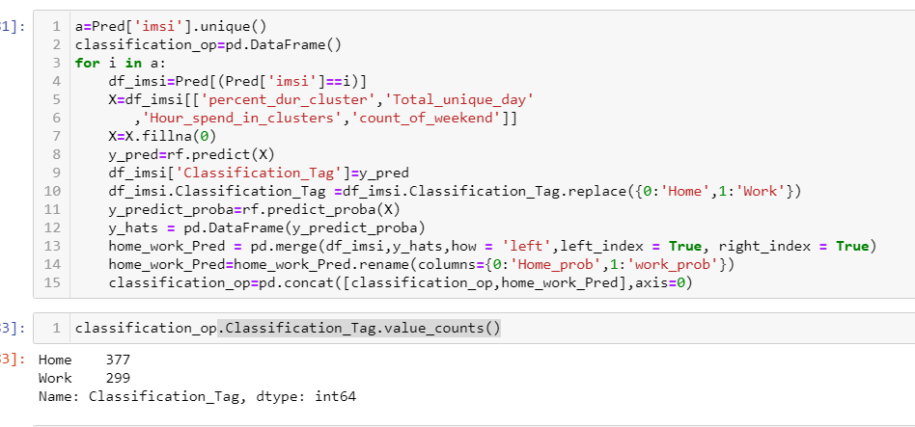
Issue in classification
We have data for 451 user
Form 451 user we have select 435 user cluster for classification on basis of bit pattern where hour spend In cluster <=3
Cluster No | Count of imsi
1 | 56
2 | 172
3 | 123
4 | 62
5 | 20
6 | 6
7 | 6
8 | 1
9 | 1
10 | 2
13 | 1
21 | 1

Slide 11
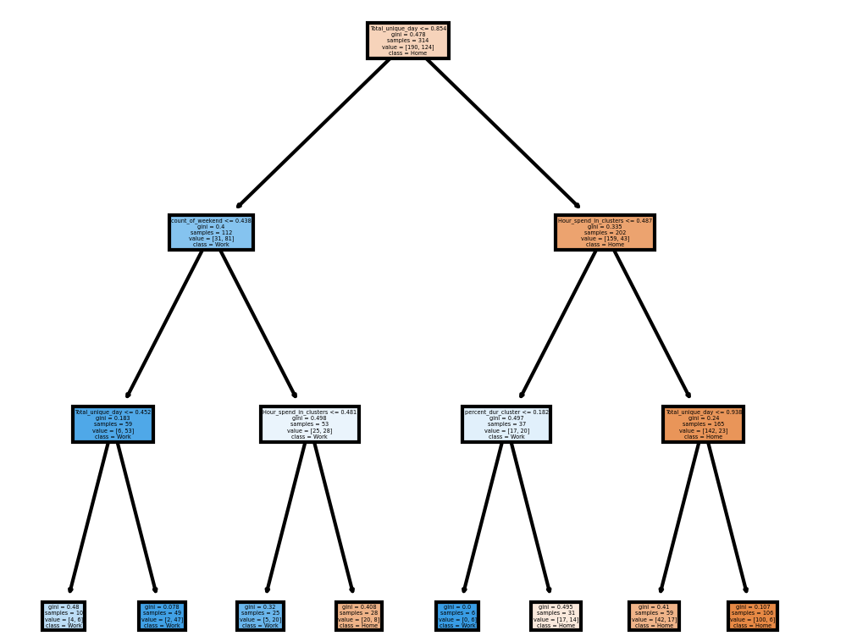
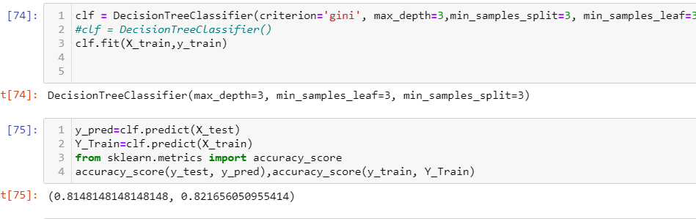
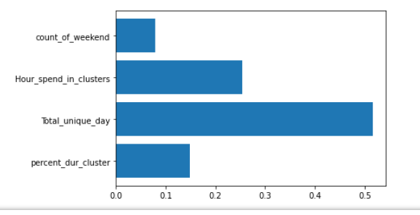
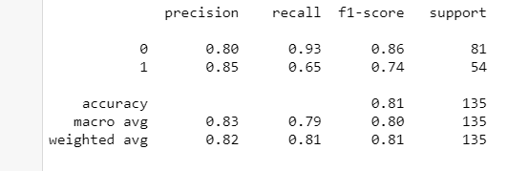

Decision Tree classification
Model tuning Parameter And accuracy
Feature importance

Slide 12
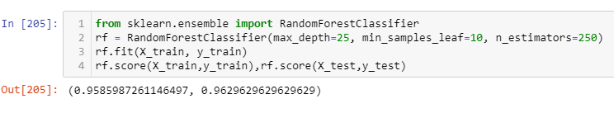
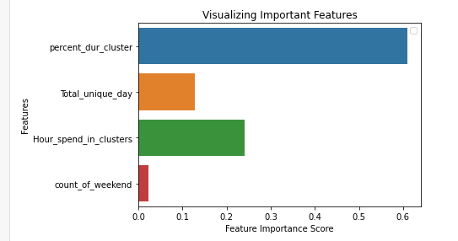
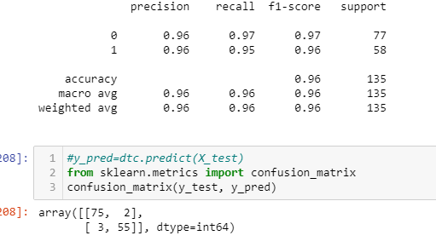
Random Forest classification

Slide 13
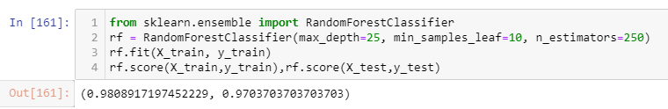
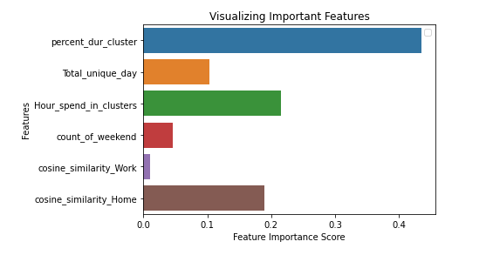
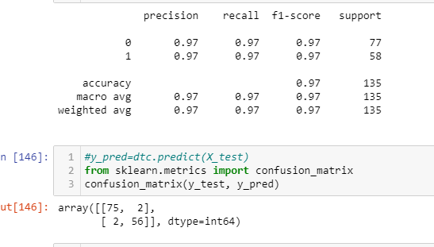
Random Forest classification with Cosine Feature

Slide 14
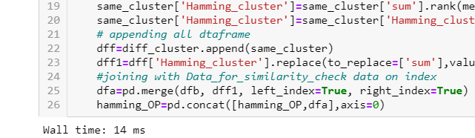

To check similar cluster
After classification check similar cluster and tag as below:
Similar home cluster tag as secondary home.
similar Work cluster tag as Secondary Work.
Rest as Hangout cluster.
To check similar cluster we use hamming Distance & Cosine Similarity
Initially we use hamming distance because it faster than cosine Similarity and it essay in execution.
But Hamming distance is also showing similarity with zero as shown in next slide. So finally we use Cosine Similarity.
Hamming
cosine

Slide 15
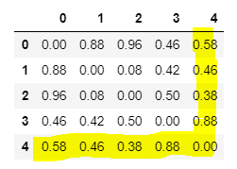
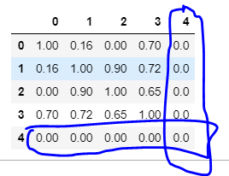
Difference b/w hamming & cosine result
Hamming
Hamming
cosine
imsi | clusters | 0 | 1 | 2 | 3 | 4 | 5 | 6 | 7 | 8 | 9 | 10 | 11 | 12 | 13 | 14 | 15 | 16 | 17 | 18 | 19 | 20 | 21 | 22 | 23
zyZCfdJiPWPioM8o7I95VT3efATg9jVC1X.+zq2ND78WyNub45Xw5QTrE2I+JStm | 1 | 1 | 1 | 0 | 1 | 1 | 1 | 1 | 1 | 0 | 0 | 0 | 0 | 0 | 0 | 0 | 0 | 0 | 1 | 1 | 1 | 1 | 1 | 1 | 1
zyZCfdJiPWPioM8o7I95VT3efATg9jVC1X.+zq2ND78WyNub45Xw5QTrE2I+JStm | 6 | 0 | 0 | 0 | 0 | 0 | 0 | 0 | 1 | 1 | 1 | 1 | 1 | 1 | 1 | 1 | 1 | 1 | 1 | 0 | 0 | 0 | 0 | 0 | 0
zyZCfdJiPWPioM8o7I95VT3efATg9jVC1X.+zq2ND78WyNub45Xw5QTrE2I+JStm | 13 | 0 | 0 | 0 | 0 | 0 | 0 | 0 | 0 | 1 | 1 | 1 | 1 | 1 | 1 | 1 | 1 | 1 | 0 | 0 | 0 | 0 | 0 | 0 | 0
zyZCfdJiPWPioM8o7I95VT3efATg9jVC1X.+zq2ND78WyNub45Xw5QTrE2I+JStm | 1000 | 1 | 1 | 0 | 0 | 0 | 1 | 1 | 1 | 1 | 1 | 1 | 1 | 1 | 1 | 1 | 1 | 1 | 1 | 1 | 1 | 1 | 1 | 1 | 1
zyZCfdJiPWPioM8o7I95VT3efATg9jVC1X.+zq2ND78WyNub45Xw5QTrE2I+JStm | 1002 | 0 | 0 | 0 | 0 | 0 | 0 | 0 | 0 | 0 | 0 | 0 | 0 | 0 | 0 | 0 | 0 | 0 | 0 | 0 | 0 | 0 | 0 | 0 | 0
So we use cosine algo to get similarity

Slide 16
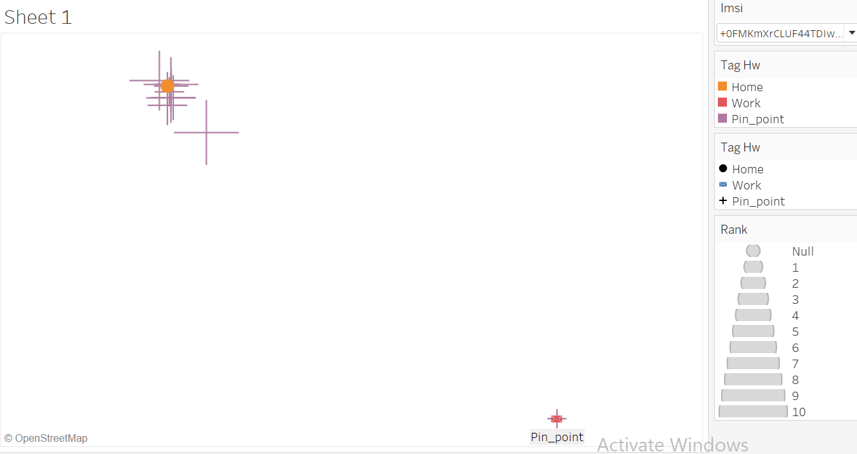
+0FMKmXrCLUF44TDIwwoT4go7vplFGHuYbr8sD4sZmMGQpFB
imsi | clusters | 0 | 1 | 2 | 3 | 4 | 5 | 6 | 7 | 8 | 9 | 10 | 11 | 12 | 13 | 14 | 15 | 16 | 17 | 18 | 19 | 20 | 21 | 22 | 23 | cosine_cluster | Classification_Tag
+0FMKmXrCLUF44TDIwwoT4go7vplFGHuYbr8sD4sZmMGQpFBfnrTnPIrnwYSHlAX | 0 | 1 | 1 | 1 | 1 | 1 | 1 | 1 | 1 | 1 | 0 | 1 | 1 | 1 | 1 | 1 | 1 | 1 | 1 | 1 | 1 | 1 | 1 | 1 | 1 | 0 | Home
+0FMKmXrCLUF44TDIwwoT4go7vplFGHuYbr8sD4sZmMGQpFBfnrTnPIrnwYSHlAX | 14 | 0 | 0 | 0 | 0 | 0 | 0 | 0 | 0 | 1 | 0 | 0 | 0 | 1 | 1 | 0 | 0 | 1 | 0 | 0 | 0 | 0 | 0 | 0 | 0 | 1 | Work
total_duration | Total_unique_day | bit_hour_sum | Count_of_Week | cluster_size(Km) | count_of_weekend
1127676 | 28 | 23 | 5 | 1.53 | 8
463873 | 16 | 4 | 4 | 0

Slide 17
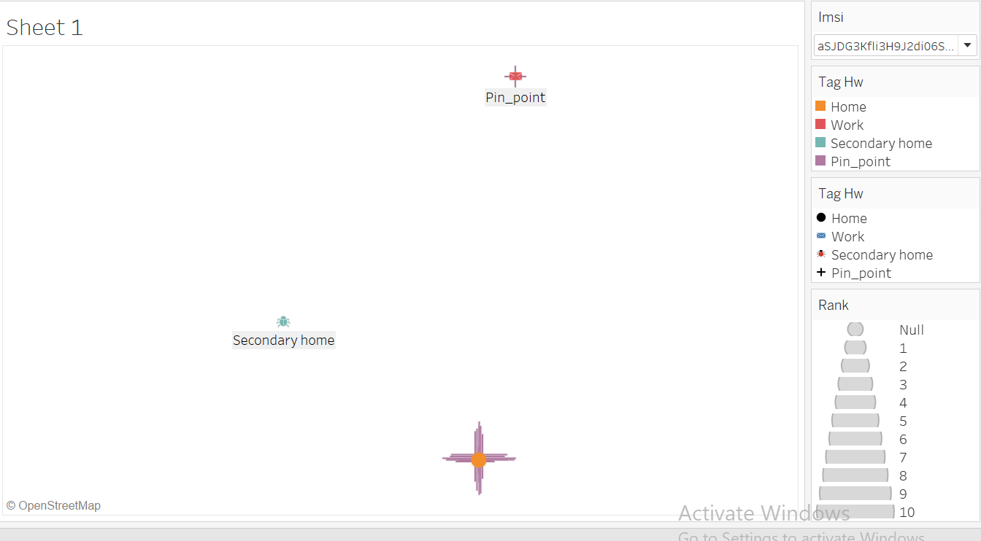
aSJDG3Kfli3H9J2di06SoQQPh9LTU80AXnOinKvUgkoA4rtuFAKar4jKakKB5tp
imsi | clusters | 0 | 1 | 2 | 3 | 4 | 5 | 6 | 7 | 8 | 9 | 10 | 11 | 12 | 13 | 14 | 15 | 16 | 17 | 18 | 19 | 20 | 21 | 22 | 23 | cosine_tag
aSJDG3Kfli3H9J2di06SoQQPh9LTU80AXnOinKvUgkoA4rtuFAKar4jKakKB5tp+ | 10 | 1 | 1 | 1 | 1 | 1 | 1 | 1 | 1 | 1 | 0 | 0 | 0 | 0 | 0 | 0 | 0 | 1 | 1 | 1 | 1 | 1 | 1 | 1 | 1 | Home
aSJDG3Kfli3H9J2di06SoQQPh9LTU80AXnOinKvUgkoA4rtuFAKar4jKakKB5tp+ | 22 | 0 | 1 | 1 | 1 | 1 | 1 | 0 | 0 | 0 | 0 | 0 | 0 | 0 | 0 | 0 | 0 | 0 | 0 | 1 | 1 | 1 | 1 | 1 | 1 | Secondary home
aSJDG3Kfli3H9J2di06SoQQPh9LTU80AXnOinKvUgkoA4rtuFAKar4jKakKB5tp+ | 13 | 0 | 0 | 0 | 0 | 0 | 0 | 0 | 1 | 1 | 1 | 1 | 1 | 1 | 1 | 1 | 1 | 1 | 1 | 1 | 1 | 0 | 0 | 0 | 0 | Work
total_duration | Total_unique_day | bit_hour_sum | Count_of_Week | cluster_size(Km) | count_of_weekend
678668 | 27 | 17 | 5 | 0.28 | 7
111304 | 10 | 11 | 3 | 1.58 | 2
509873 | 24 | 13 | 4 | 0 | 7

Slide 18
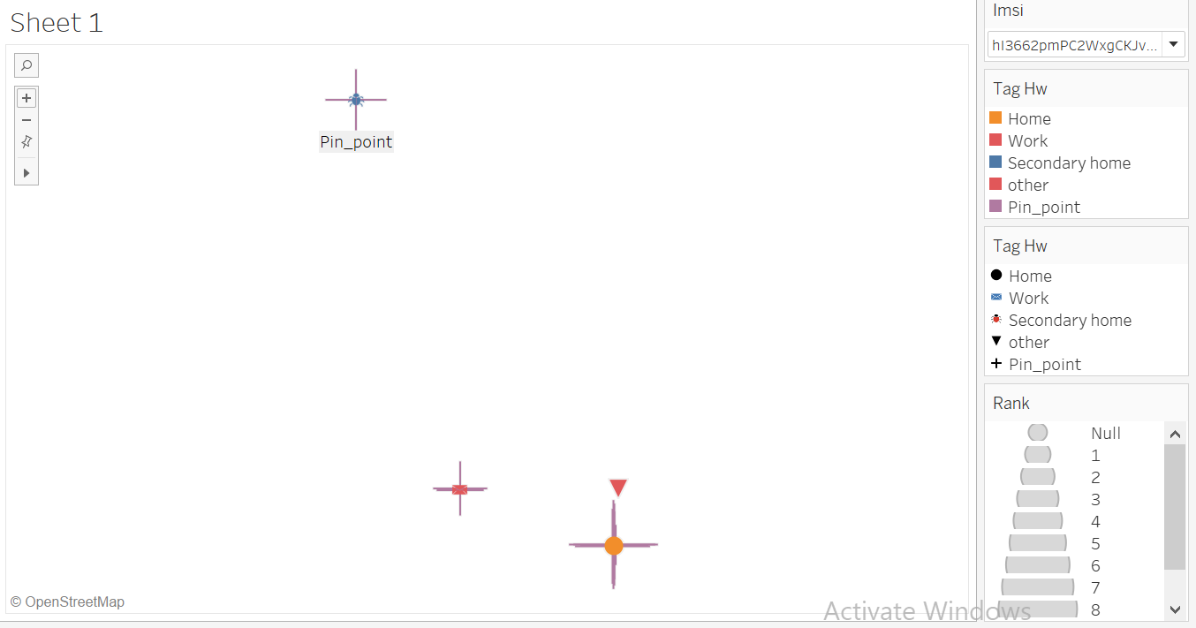
hI3662pmPC2WxgCKJvT9Rwa5CGnwO01Yvoe1Alo.xuIwhluR69IhSBwFCGbBJZvv
imsi | clusters | 0 | 1 | 2 | 3 | 4 | 5 | 6 | 7 | 8 | 9 | 10 | 11 | 12 | 13 | 14 | 15 | 16 | 17 | 18 | 19 | 20 | 21 | 22 | 23 | cosine_tag
hI3662pmPC2WxgCKJvT9Rwa5CGnwO01Yvoe1Alo.xuIwhluR69IhSBwFCGbBJZvv | 0 | 1 | 1 | 1 | 0 | 1 | 1 | 1 | 1 | 1 | 1 | 1 | 1 | 1 | 0 | 1 | 1 | 1 | 1 | 1 | 1 | 1 | 1 | 1 | 1 | Home
hI3662pmPC2WxgCKJvT9Rwa5CGnwO01Yvoe1Alo.xuIwhluR69IhSBwFCGbBJZvv | 73 | 1 | 1 | 1 | 1 | 1 | 1 | 1 | 1 | 1 | 1 | 1 | 1 | 1 | 1 | 1 | 1 | 1 | 1 | 1 | 1 | 1 | 1 | 1 | 0 | Secondary home
hI3662pmPC2WxgCKJvT9Rwa5CGnwO01Yvoe1Alo.xuIwhluR69IhSBwFCGbBJZvv | 10 | 0 | 0 | 0 | 0 | 0 | 0 | 0 | 0 | 1 | 1 | 1 | 1 | 1 | 1 | 1 | 1 | 1 | 1 | 1 | 0 | 0 | 0 | 0 | 0 | Work
hI3662pmPC2WxgCKJvT9Rwa5CGnwO01Yvoe1Alo.xuIwhluR69IhSBwFCGbBJZvv | 1007 | 0 | 0 | 0 | 0 | 0 | 0 | 0 | 0 | 0 | 0 | 0 | 0 | 0 | 0 | 0 | 0 | 1 | 1 | 1 | 0 | 0 | 0 | 0 | 0 | other
total_duration | Total_unique_day | bit_hour_sum | Count_of_Week | cluster_size(Km) | count_of_weekend
1023582 | 19 | 22 | 5 | 0.32 | 5
661919 | 12 | 23 | 2 | 0.31 | 3
209304 | 6 | 11 | 1 | 3.84 | 1
32831 | 12 | 3 | 5 | 4.81 | 3

Slide 19
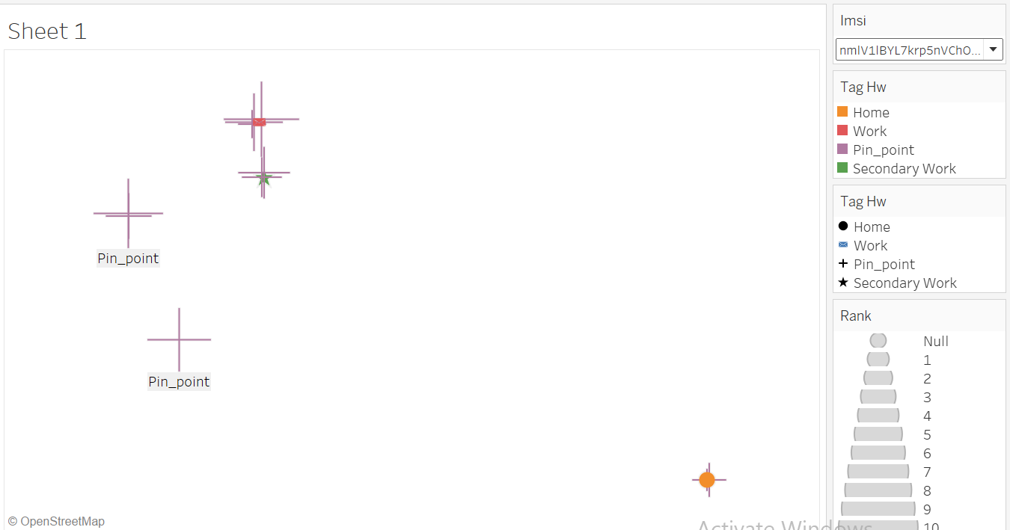
nmlV1lBYL7krp5nVChOeGIt0GOCygTPZQS5h9OnZGZTkkxOwyRDN6Sl7p0aKc6um
imsi | clusters | 0 | 1 | 2 | 3 | 4 | 5 | 6 | 7 | 8 | 9 | 10 | 11 | 12 | 13 | 14 | 15 | 16 | 17 | 18 | 19 | 20 | 21 | 22 | 23 | cosine_tag
nmlV1lBYL7krp5nVChOeGIt0GOCygTPZQS5h9OnZGZTkkxOwyRDN6Sl7p0aKc6um | 0 | 1 | 0 | 1 | 1 | 0 | 0 | 1 | 0 | 0 | 0 | 0 | 0 | 0 | 0 | 0 | 0 | 0 | 0 | 0 | 1 | 1 | 1 | 0 | 0 | Home
nmlV1lBYL7krp5nVChOeGIt0GOCygTPZQS5h9OnZGZTkkxOwyRDN6Sl7p0aKc6um | 1018 | 0 | 0 | 0 | 0 | 0 | 0 | 0 | 0 | 0 | 0 | 1 | 1 | 0 | 1 | 1 | 1 | 1 | 1 | 1 | 1 | 0 | 0 | 0 | 0 | Secondary Work
nmlV1lBYL7krp5nVChOeGIt0GOCygTPZQS5h9OnZGZTkkxOwyRDN6Sl7p0aKc6um | 1021 | 0 | 0 | 0 | 0 | 0 | 0 | 0 | 0 | 1 | 1 | 1 | 1 | 1 | 1 | 1 | 1 | 1 | 1 | 1 | 1 | 0 | 1 | 0 | 0 | Work
total_duration | Total_unique_day | bit_hour_sum | Count_of_Week | cluster_size(Km) | count_of_weekend
863061 | 26 | 7 | 5 | 1.03 | 6
103667 | 17 | 9 | 4 | 1.6 | 1
366735 | 19 | 13 | 5 | 1.78 | 2

Slide 21
Thanks

Slide 22
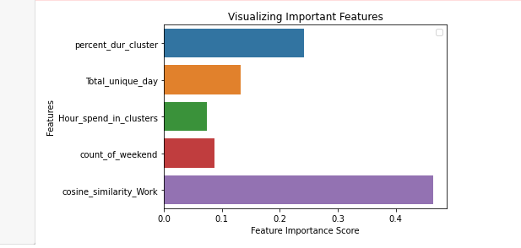
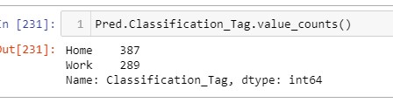

Slide 23
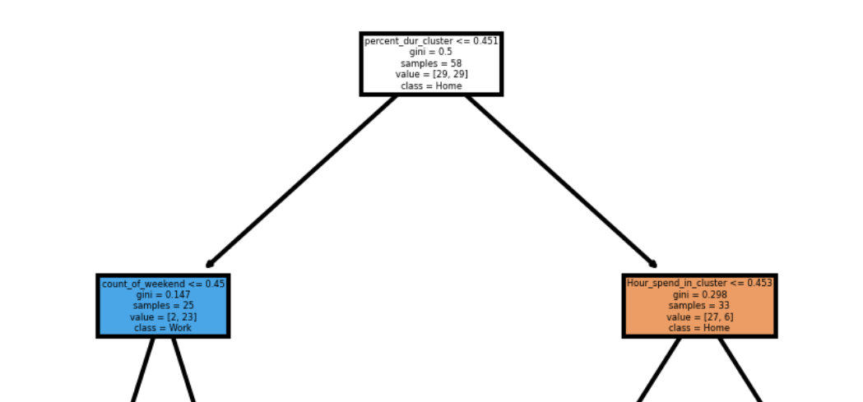
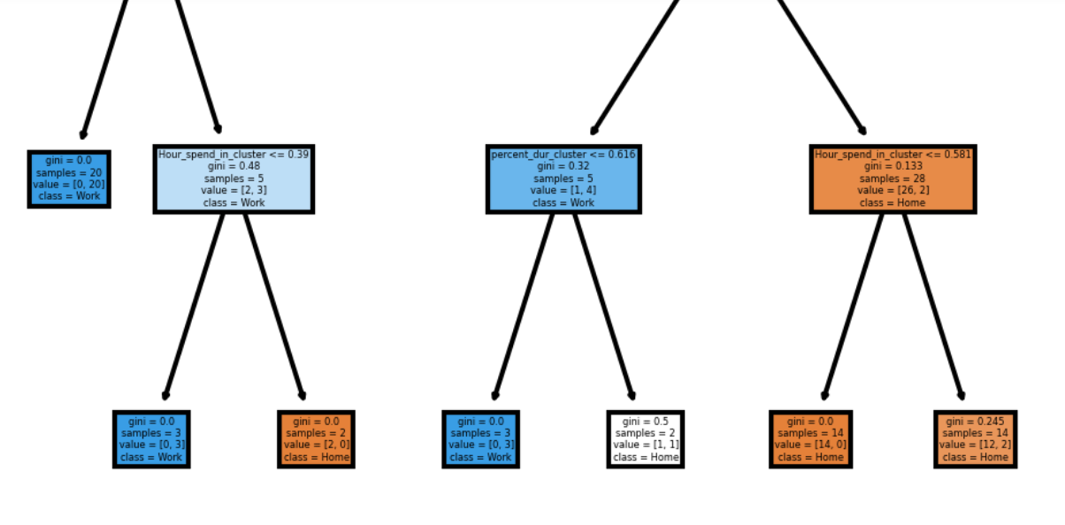
Decision Tree

Slide 24
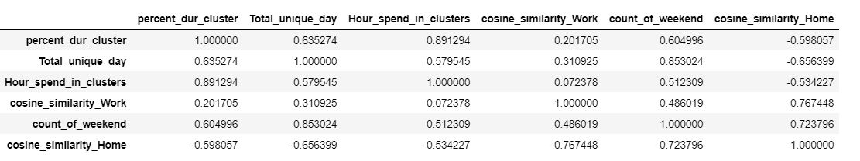
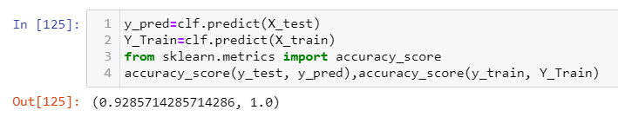
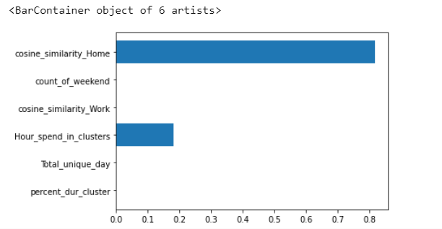
Decision tree on all feature case1
Correlation
Accuracy

Slide 25
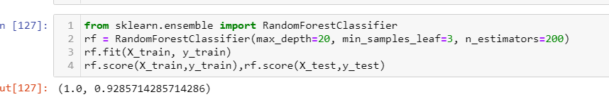
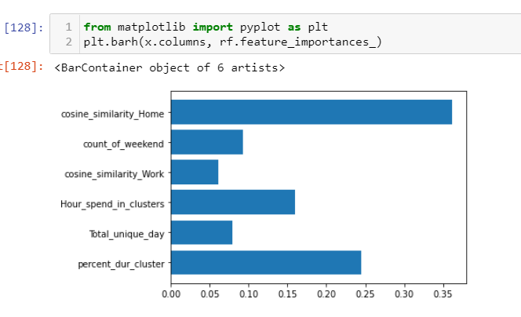
Random Forest on all feature case 1

Slide 26
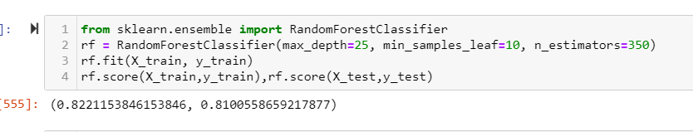
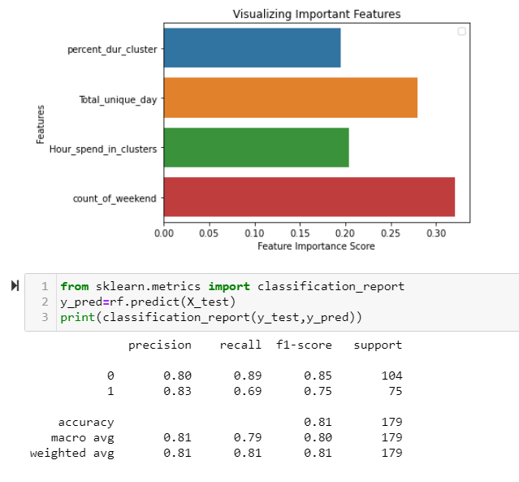
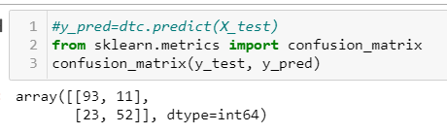
Random forest(if we remove hamming Distance)
Result are not good

Slide 27
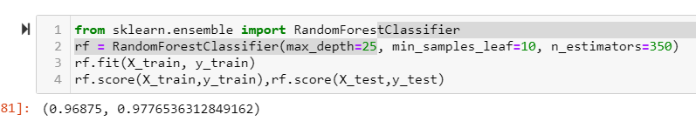
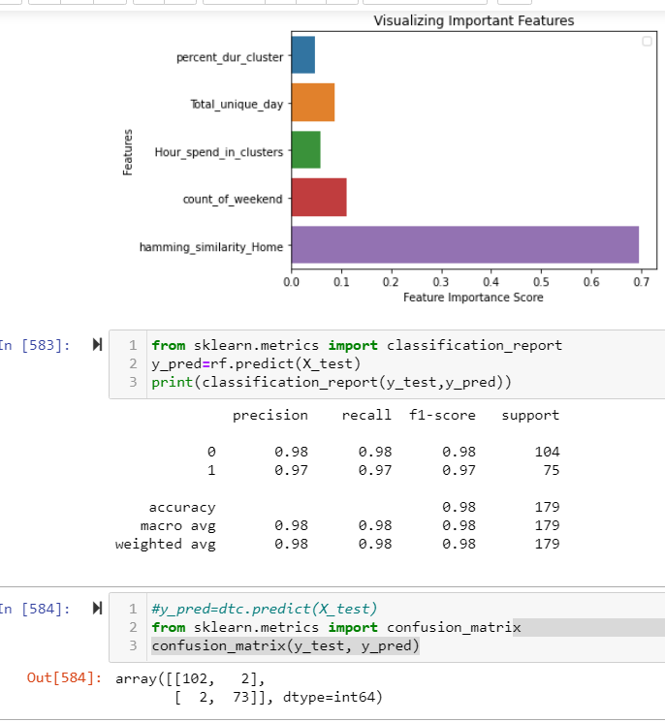
Random forest(with hamming Distance factor)
Result are looking good

Slide 28
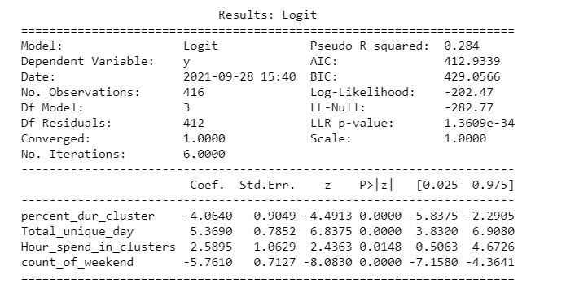
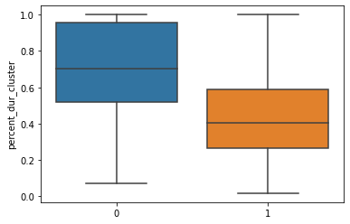
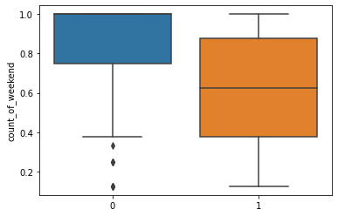
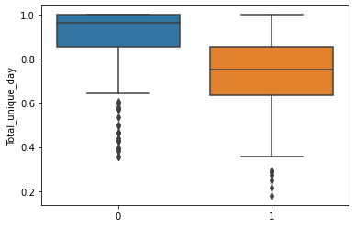
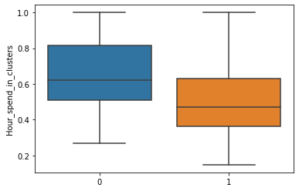
Logistic regression

Slide 29
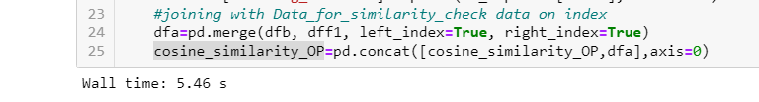
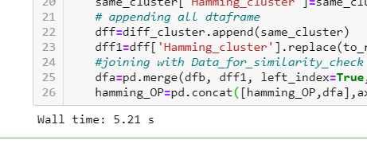
Cosine time vs hamming time

Slide 30
Problem statement
we have 35 user data with manual home & work tagging. We need to create decision tree to identify rules
Solution
Below feature are created on cluster level and filter user which have Grater that equal to 10 days in both cluster
percent_dur_cluster: take sum of total duration spend in cluster & get % duration spend in each cluster
Total_unique_Hours: take unique hour spend in cluster & divide with 24.
Total_unique_day:Take Unique day spend in cluster & divide with no of unique day data of user
count_of_weekday: Take Unique weekday spend in cluster & divide with no of unique weekday data of user
count_of_weekend: Take Unique weekend spend in cluster & divide with no of unique weekend data of user
Occurrence: Take sum of Occurrence spend in cluster & get % Occurrence spend in each cluster
weekday_Occurrence: Take sum of weekday Occurrence spend in cluster & get % weekday Occurrence spend in each cluster
weekend_Occurrence: Take sum of weekend Occurrence spend in cluster & get % Occurrence spend in each weekend cluster

Slide 31
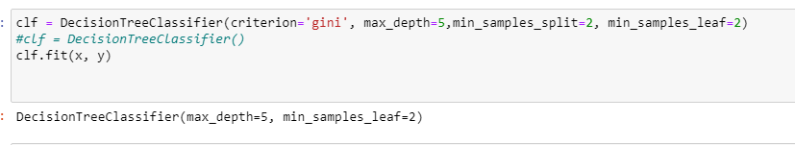
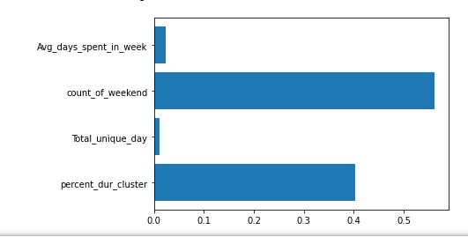

Parameter of decision tree

Slide 32
Rule:
if weekend_Occurrence>0.5 & Per_duration_Cluster > 0.568 then tag ='Home'
if weekend_Occurrence>0.5 & Per_duration_Cluster <= 0.568 & Per_duration_Cluster > 0.504 & Weekday_occ <= 0.733 then tag ='work'
if weekend_Occurrence>0.5 & Per_duration_Cluster <= 0.568 & Per_duration_Cluster > 0.504 & Weekday_occ > 0.73 then tag ='Home'
if weekend_Occurrence>0.5 & Per_duration_Cluster <= 0.568 & Per_duration_Cluster <= 0.504 & count_of_Weekday <= 0.458 then tag ='work'
if weekend_Occurrence>0.5 & Per_duration_Cluster <= 0.56 & Per_duration_Cluster <= 0.504 & count_of_Weekday <= 0.458 then tag ='home'
if weekend_Occurrence<= 0.5 & Total_unique_day > 0.848 then tag ='Home'
if weekend_Occurrence<= 0.5 & Total_unique_day <= 0.848 & count_of_weekend > 0.688 then tag ='Home'
if weekend_Occurrence<= 0.5 & Total_unique_day <= 0.848 & count_of_weekend <= 0.688 & percent_dur_cluster <= 0.432 then tag ='Work'
if weekend_Occurrence<= 0.5 & Total_unique_day <= 0.848 & count_of_weekend <= 0.68 & percent_dur_cluster > 0.432 & total_unique day <=0.563 then tag ='Home'
if weekend_Occurrence<= 0.5 & Total_unique_day <= 0.848 & count_of_weekend <= 0.68 & percent_dur_cluster > 0.432 & total_unique day >0.563 then tag ='work'

Slide 33
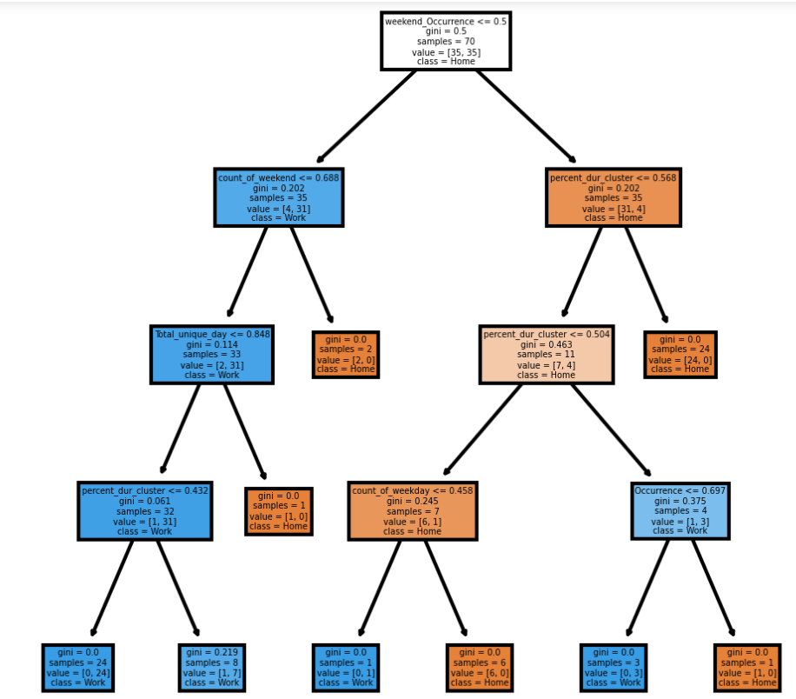
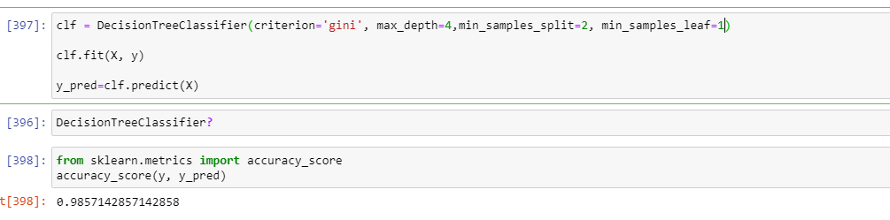
Model tuning Case 1

Slide 34
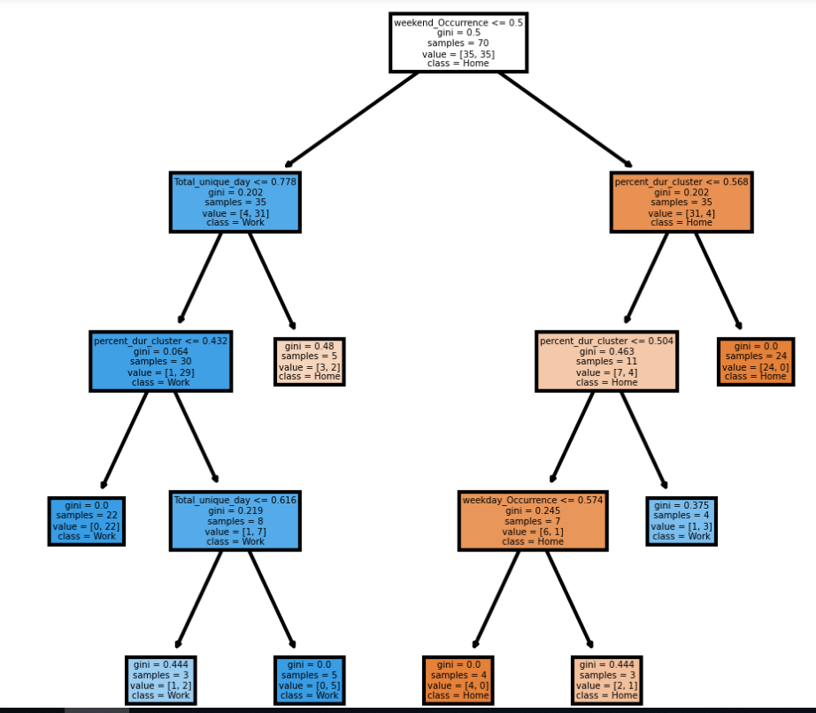
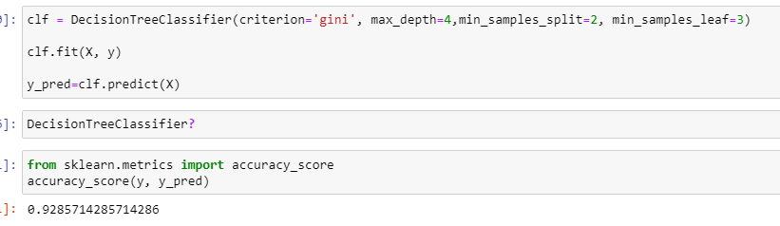
Model tuning Case 2

Slide 35
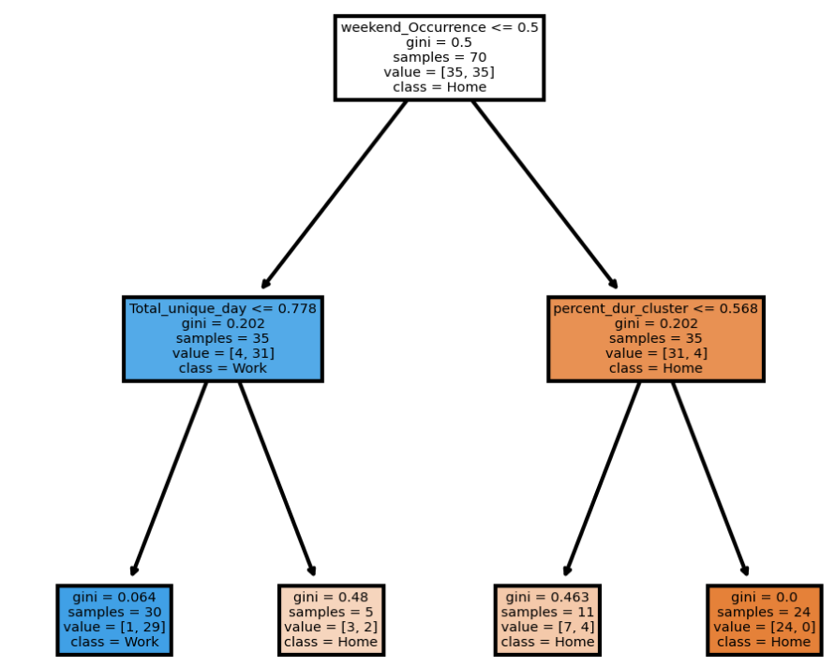
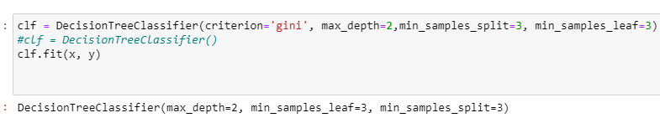
Model tuning case 3

Slide 36
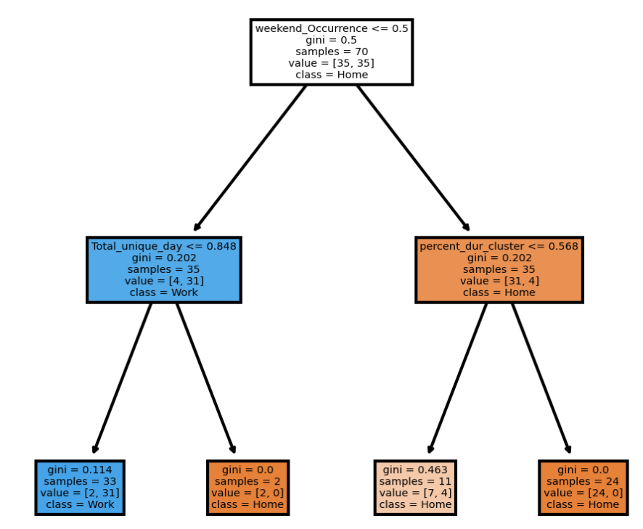
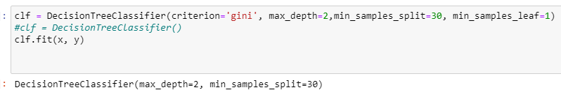
Using Grid search best parameter

Slide 37
V2 of Decision tree

Slide 38
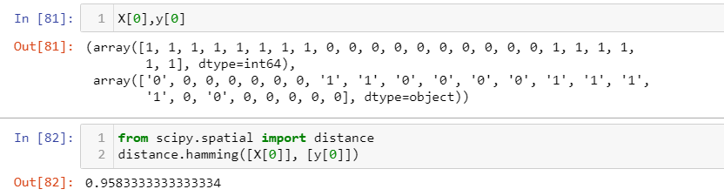



Difference b/w hamming & cosine result
Hamming
cosine
So we use cosine algo to get similarity

